Slide 1

Projecting Future LNG Imports
National Energy Modeling System / Annual Energy Outlook Conference
Phyllis Martin
Energy Information Administration (EIA)
March 18, 2003
Washington, DC

Slide 2
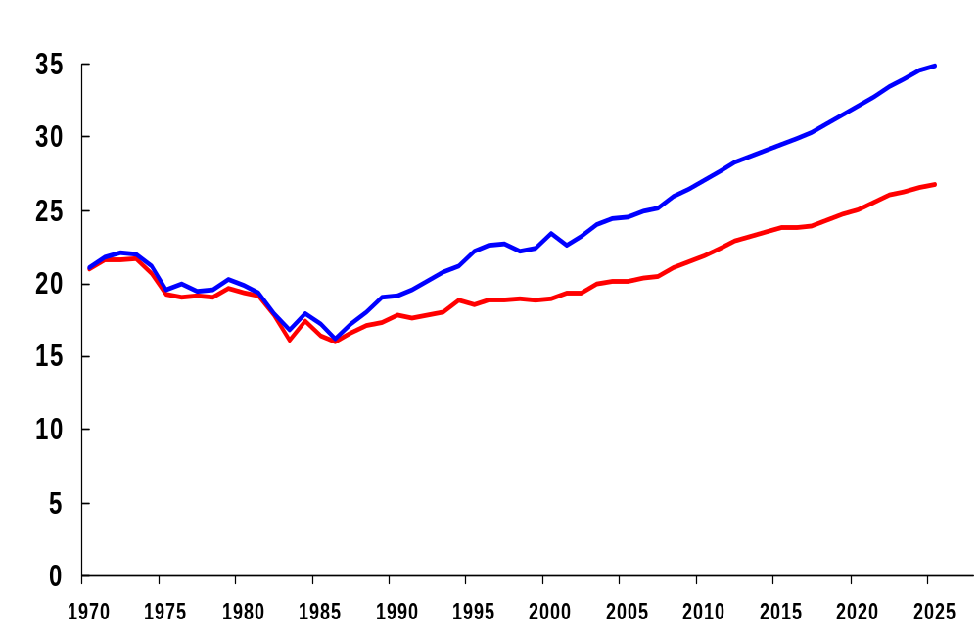
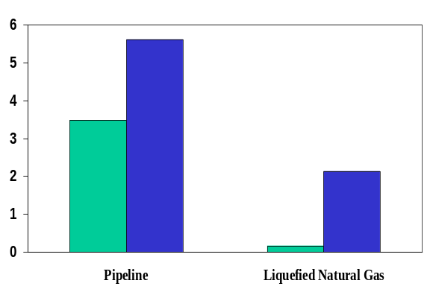
Natural Gas Production, Consumption, and Imports,
1970 - 2025 (trillion cubic feet)
History
Projections
Net Imports
Consumption
Natural Gas Net Imports, 2001 and 2025
Production
(trillion cubic feet)
2025
2001

Slide 3
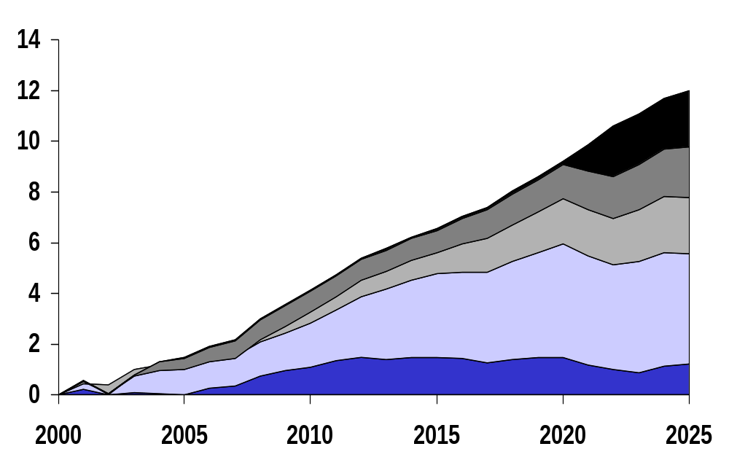
Sources of Incremental Natural Gas Supply,
2000-2025 (trillion cubic feet)
Growth in Alaskan Production
18%
Growth in Net LNG Imports
16%
Growth in Net Pipeline Imports
19%
Growth in L48 Conventional
Production*
36%
Growth in L48 Unconventional Production
10%
* Includes supplemental supplies

Slide 4
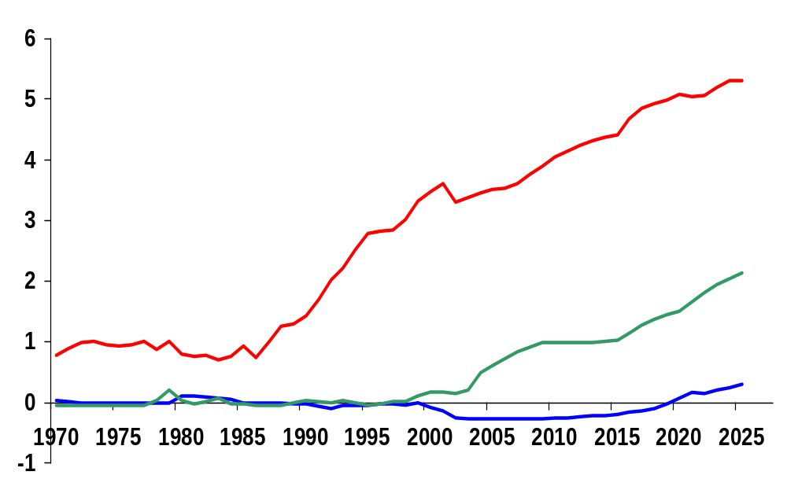
Net U.S. Imports of Natural Gas, 1970-2025
(trillion cubic feet)
History
Projections
Canada
LNG
Mexico

Slide 5
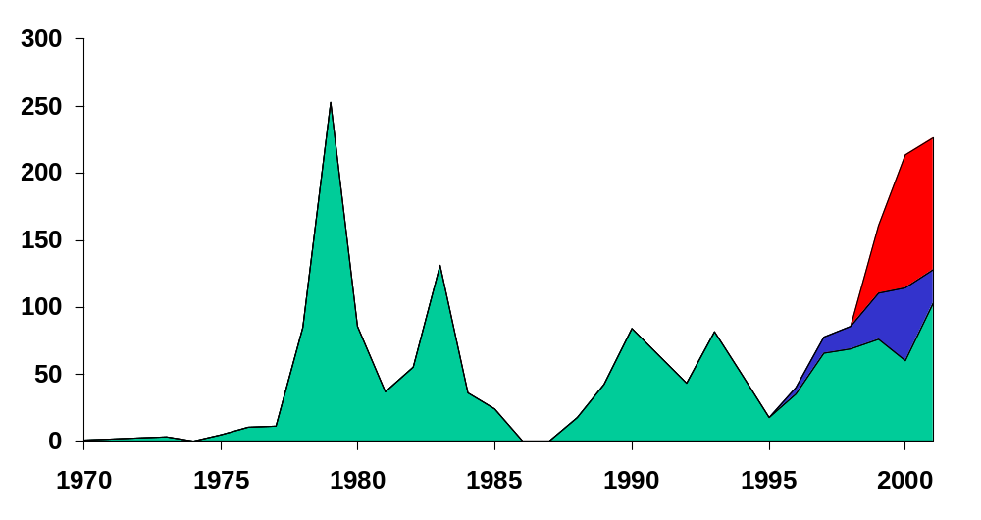
U.S. LNG Imports by Source Country, 1970-2001 (billion cubic feet)
Trinidad/Tobago
Others*
Algeria/Nigeria
* Include Australia, Qatar, and UAE

Slide 6
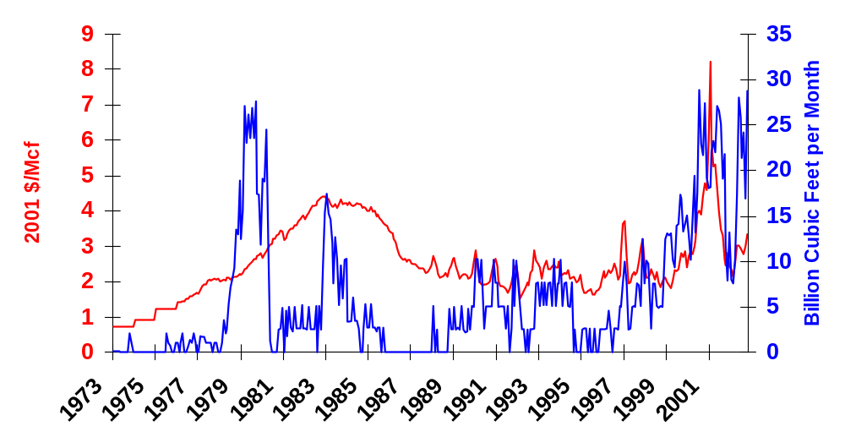
Monthly Gross LNG Imports and
Average Wellhead Price
Imports
Prices

Slide 7
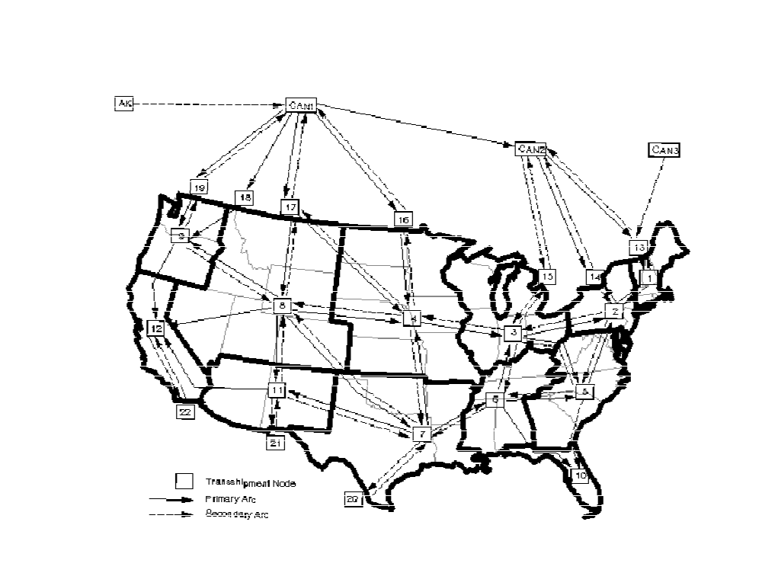
Representation of Natural Gas Transmission Network and LNG Import Facilities in NEMS
Representation of Existing LNG Facilities
Representation of Potential LNG Facilities

Slide 8
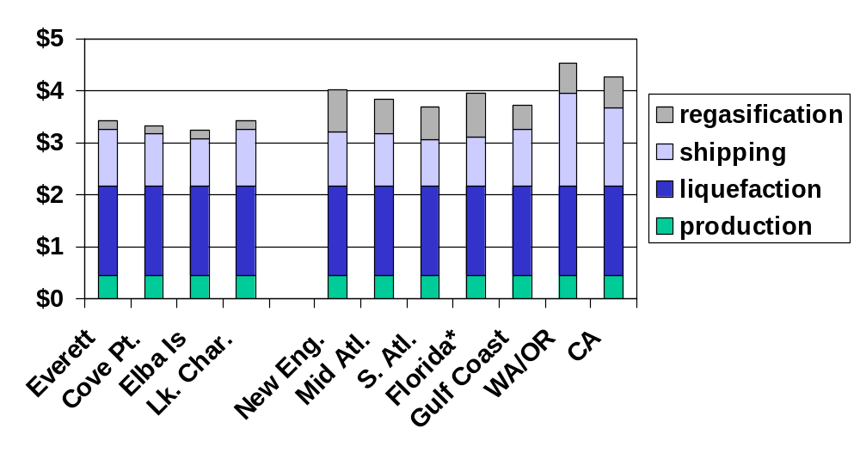
Minimum Regional LNG Costs
(2001 dollars per thousand cubic feet)
Existing
New
* Regasification includes pipeline cost from Bahamas

Slide 9
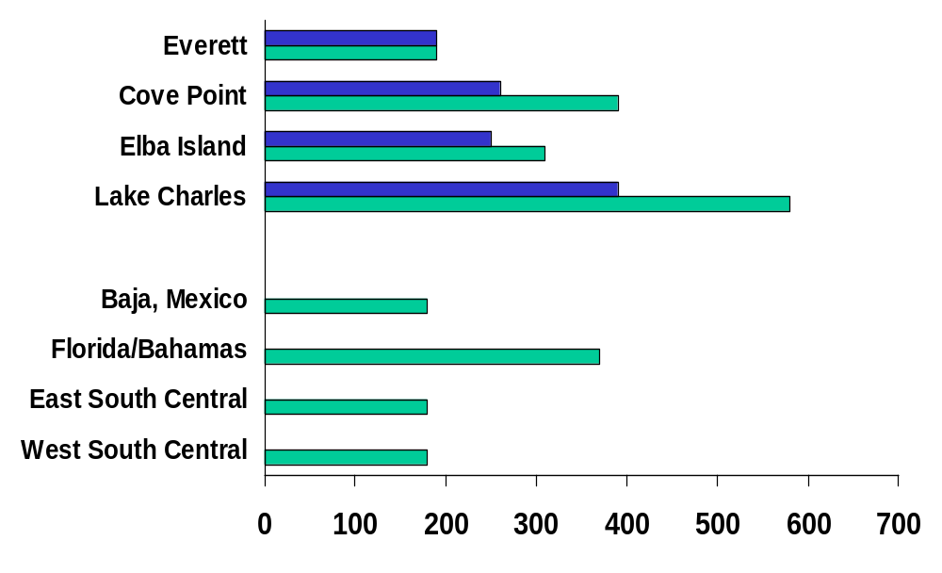
Projected LNG Imports by Terminal and/or Region, 2015 and 2025
(billion cubic feet)
2015
2025

Slide 10
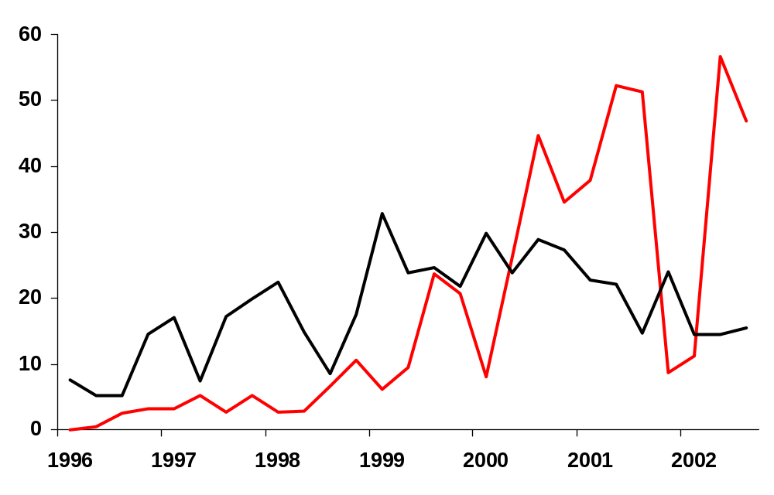
Quarterly LNG Imports by Contract Type
(billion cubic feet per quarter)
Short-Term
Long-Term

Slide 11
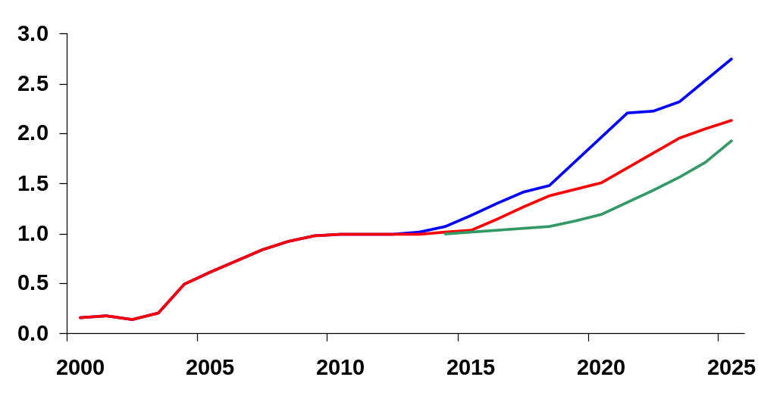
Projected Net LNG Imports, 2000-2025
(trillion cubic feet)
Oil and gas slow technology case
Reference case
Oil and gas rapid technology case

Slide 12
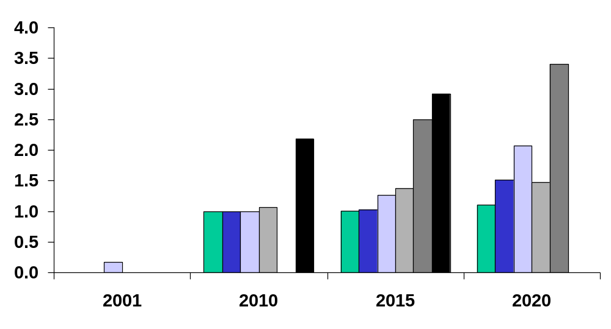
Comparison of Net LNG Import Forecasts
(trillion cubic feet)
History
Projections
PIRA
EEA
GII
AEO HMAC
AEO 2003
AEO LMAC
EEA (N/A)

